Slide 1
Title: Uber Fares Dataset Analysis
Introduction to Big Data Analytics Assignment

Slide 2
Names:twakira Agape gift id: 27320
Assignment date: 22 july 2025
Instructor: Eric Maniraguha | eric.maniraguha@auca.ac.rw | LinkedIn Profile

Slide 3
Introduction
Content:
Goal: Analyze Uber ride data using Python and Power BI.
Dataset includes fare prices, timestamps, and geographic info.
Tools:
Python (VS Code): Data cleaning and EDA.
Power BI: Visualizations and dashboard creation.

Slide 4
Methodology
Steps Taken:
Downloaded dataset from Kaggle.
Loaded into Python using Pandas.
Cleaned missing values & parsed datetime.
Engineered new features (hour, day, weekday).
Exported cleaned CSV for Power BI.
Built interactive dashboard in Power BI.

Slide 5
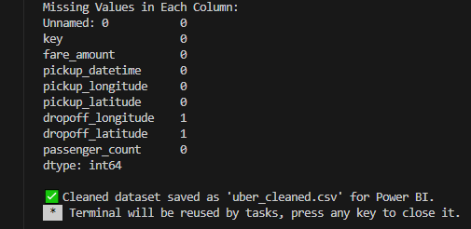
Data Cleaning Process
Actions Performed:
Dropped rows with missing fare or timestamps.
Parsed pickup datetime into time columns.
Removed unrealistic outliers (e.g., negative fares).

Slide 6
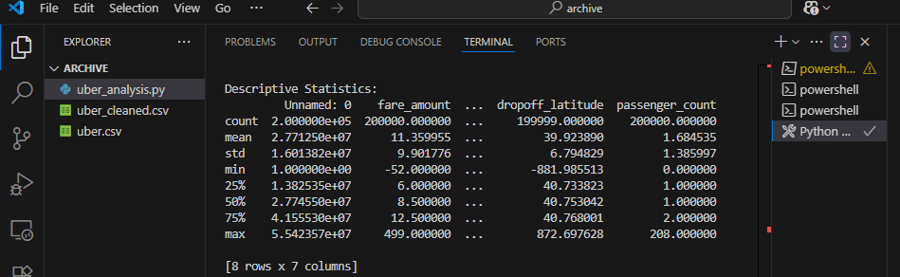
Exploratory Data Analysis (EDA)
Statistical Analysis in Python:
Calculated mean, median, mode, std dev.
Outliers identified using IQR.
Explored fare distribution.

Slide 7
Ride Frequency Analysis
Time-based Insights:
Most rides occur during 5 PM - 8 PM.
Weekends show higher ride frequency.
Screenshot added below

Slide 8
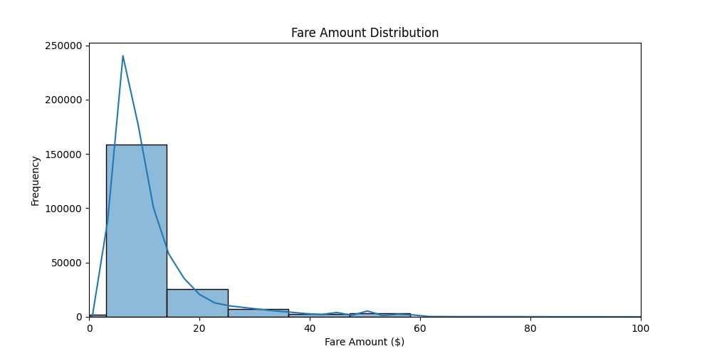
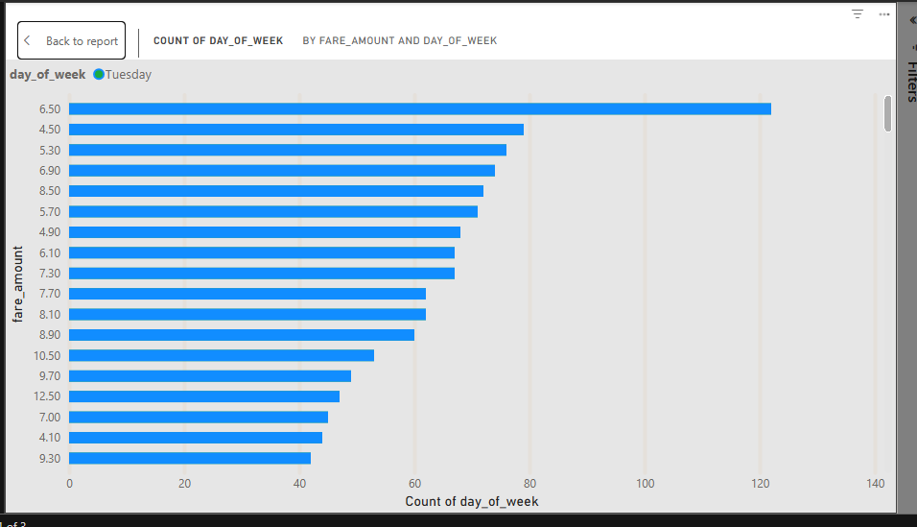
fare_distribution_histogram and count day of week by fare_amount and day_of_week

Slide 9
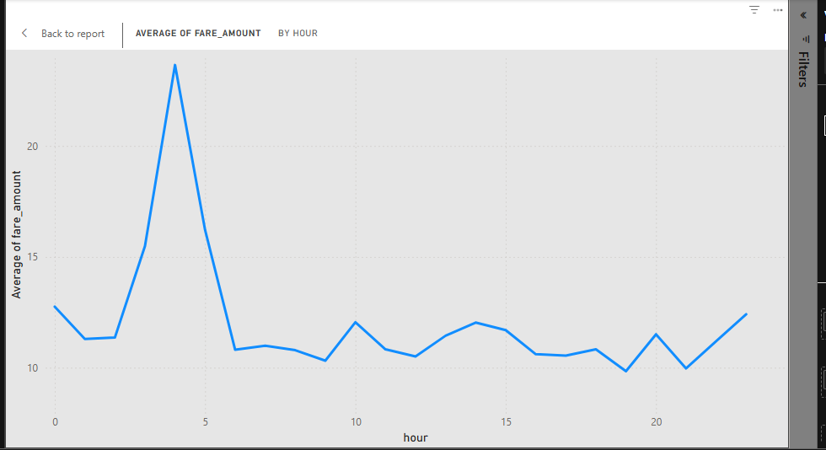
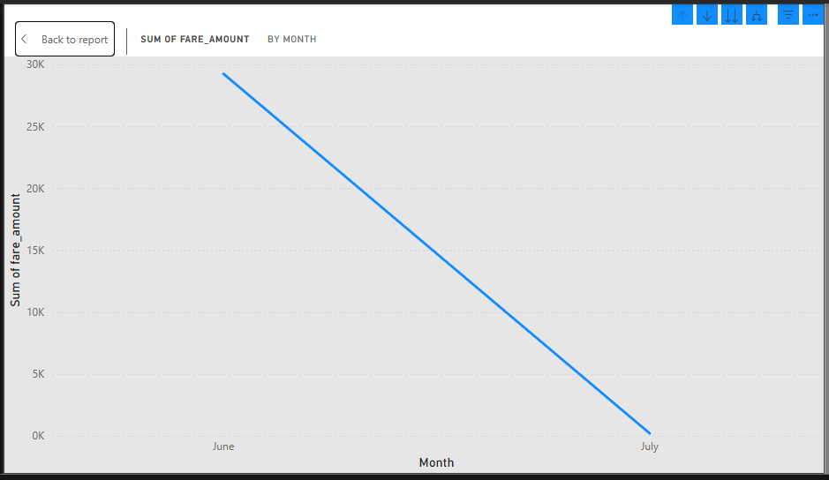
Average of fare_Amount By hour and sum of Fare_amount by month

Slide 10
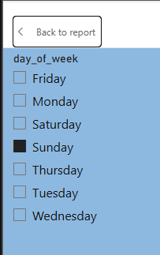
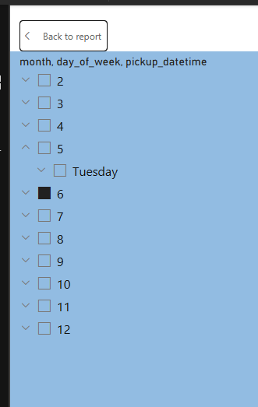
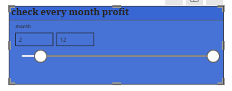
day of week ,month, day of week pickup_datetime and also check ever month profit

Slide 11
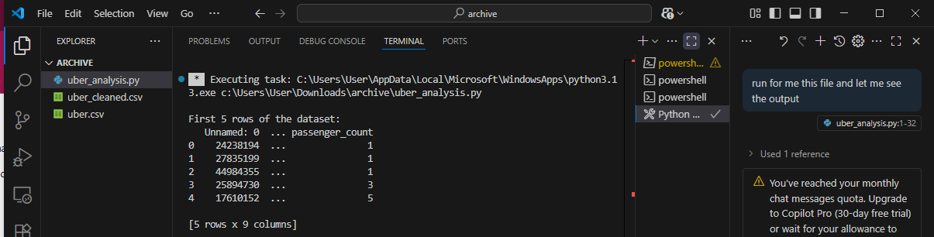
Display the first 5 rows of the dataset

Slide 12
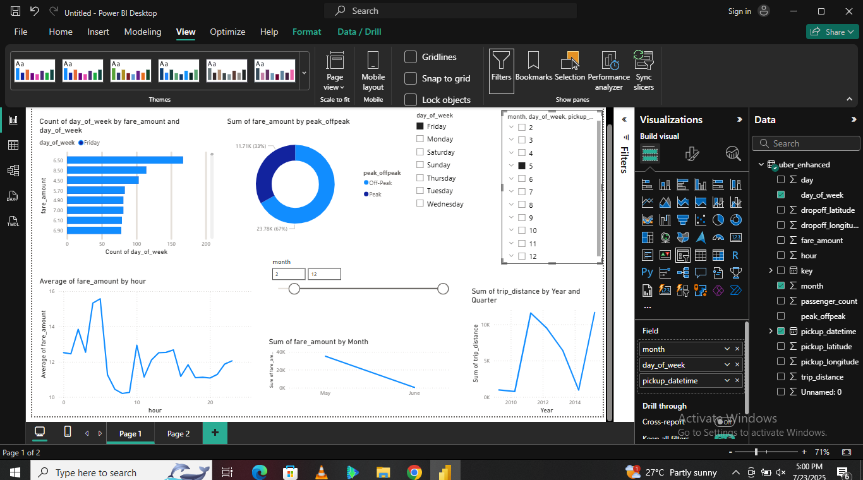
Power BI Dashboard Overview
Dashboard Highlights:
Time series: Fares across days/months.
Map visuals showing pickup density.
Interactive slicers and filters.
Screenshot add below

Slide 13
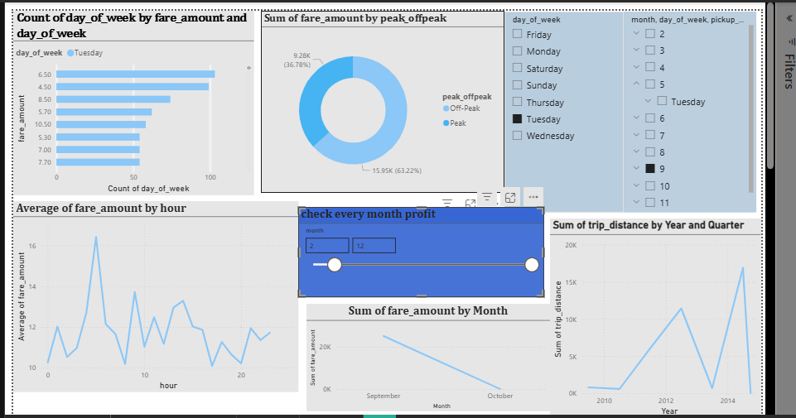
The fare uber dataset dashboard

Slide 14
Key Findings
Insights Discovered:
Fares increase with distance but not linearly.
Evening hours are the busiest.
Urban areas have the highest ride concentration.

Slide 15
Recommendations
Based on the Analysis:
Apply surge pricing during peak hours.
Target low-ride zones with promotions.
Investigate frequent outliers for fraud.

Slide 16
Conclusion
Wrap-up:
Data-driven insights support pricing and planning.
Python prepped the data; Power BI visualized insights.
Future work: Integrate weather or traffic data.

